Slide 1
COALA IP Protocol

Slide 2
Goals
A licensing framework for digital assets that:
Is easily approachable by all participants (devs, rights holders, copyright societies, …)
Is easily extensible and future-proof
Guarantees immutability and tamper-resistance
Is blockchain-agnostic
Is free (free as in FOSS) for everyone to participate and use

Slide 3
History
COALA - organize blockchain workshops & working groups. Meet 3-4 times per year.
COALA IP working group started in fall 2015
Contributors from COALA, IPFS, Ujo / Consensys, Mycelia, ascribe / BigchainDB, Synereo, mediachain, more. - Relations with Copyright Hub, Open Music Initiative, many blockchain IP startups - Bolt into Ethereum, IPFS, IPDB (public BigchainDB)
Mantra: invent as little as possible, reuse well-considered building blocks

Slide 4
Building blocks
LCC framework, it’s concise and applicable Generalizes DDEX (music), PLUS (photos), more By Copyright Hub with 90 partner orgs
Linked Data, it’s easily extensible JSON-LD: URI-linking of JSON objects
IPLD, for cryptographically verifiable integrity Via Merkle-linking of JSON objects
Interledger Protocol, allows IP to live on many ledgers Linking of ordered transactions on blockchains

Slide 5
The LCC Framework
A standard that generalizes existing, widely used IP standards, including DDEX (music), PLUS (photos)
Documentation:
LCC Ten Targets for a Rights Network
LCC Principles of Identification
LCC Entity Model (short: LCC EM)
LCC Rights Reference Model (short: LCC RRM)
Notes:
The four documents described were mostly used in the specification
Mainly the LCC RRM was considered, as it features proper data models for digital licensing
The LCC EM was discarded as it was just a base/meta model. As a replacement RDF was used (fairly similar)
As the conclusion says: they were all written in an implementation-agnostic style (meaning they are unopinionated about technologies)

Slide 6
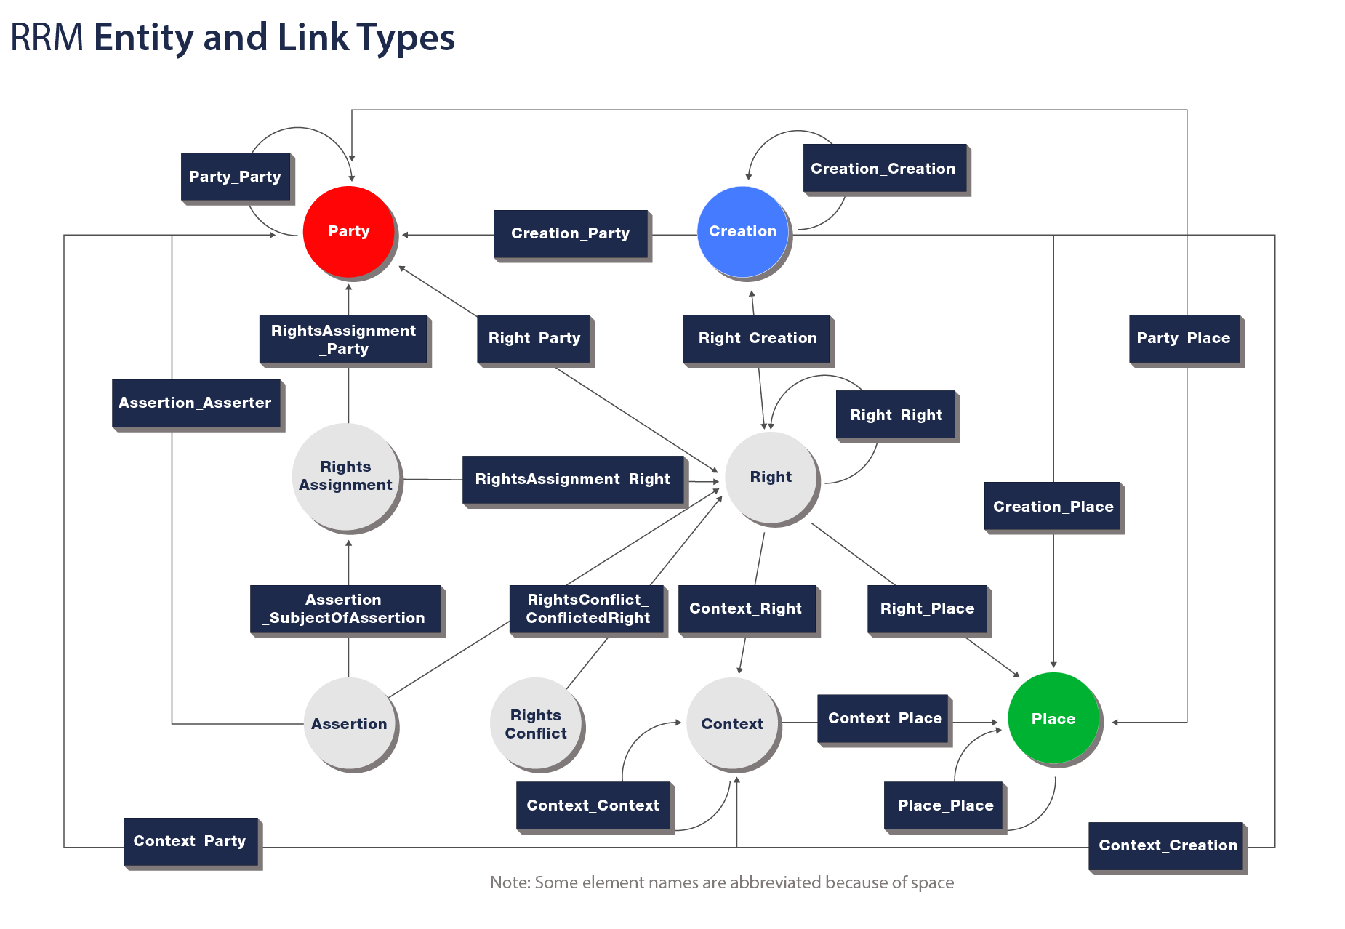
The LCC Rights Reference Model
Represent IP rights digitally
Data model on top of the LCC EM
⇒ 7 (main) entities
Notes:
Picture shows it clearly: Everything is connected to everything
LCC RRM is a theoretical model, so everything was composed to link to everything
In an actual implementation with JSON-LD and IPLD, this will not pose a problem. Why? Because RDF
Context is ignored as an entity, as in the LCC RRM it’s just an abstract class that allows all kinds of types to be linked
⇒ Hence: 7 main entities

Slide 7
IPLD
Merkle-linking JSON objects
Cryptographic integrity-checking of data
Merkle-paths JSON objects
Content-addressable data/storage
Notes:
Basically IPLD is two things:
It allows cryptographical integrity-checking of data by merkle-linking json objects
It allows to retrieve data using paths and content-addressed storage

Slide 8
IPLD: Merkle-Linking example
import ipld
In [2]: person = {
...: "givenName": "Andy",
...: "familyName": "Warhol",
...: "birthDate": "1928-08-06"
...: }
In [3]: serialized_person = ipld.marshal(person) # serialize using CBOR
Out[3]: b'\xa3ibirthDatej1928-08-06jfamilyNamefWarholigivenNamedAndy'
In [4]: ipld.multihash(serialized_person) # hash CBOR value and get a hash digest
Out[4]: ‘QmRinxtytQFizqBbcRfJ3i1ts617W8AA8xt53DsPGTfisC’
Notes:
We’re importing ipld as a Python package
We’re creating a regular Python dicts
We’re serializing the Python dict using a function of IPLD called ‘marshal’
The result is a binary string representation
Internally, the object is regularily transformed to a CBOR
If a property of type {‘/’: <IPLD hash>} is encountered, then it’s value is tagged with IANA CBOR Tag 258 (Juan Benet wants to register this tag for IPLD)
We’re ‘multihashing’ the object
The object is hashed with an arbitrary hash function (in our case SHA2-256 - don’t panic, it works with whatever fn you prefer)
However, the hash is also prefixed with a hexadecimal value representing the hash function it was hashed with (self-identifying hash function so to speak)
And woops: We have our first IPLD hash

Slide 9
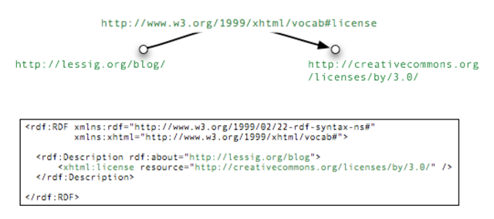
Linked Data:
Resource Description Framework (short: RDF)
A way to express assertions in a schematic way
Notes:
Vocabulary: A RDF statement always consists of three parts: Subject - Predicate - Object
All three entities are links (URIs) pointing somewhere
Subject: Lessig’s blog
Predicate: xhtml’s RDF schema definition of a license
Object: The CreativeCommons Attribution license

Slide 10
Linked Data: JSON-LD
A data structure to serialize RDF in JSON
{ "@type": "http://schema.org/Person", "@id": "http://example.com/data/AndyWarhol", "givenName": "Andy", "familyName": "Warhol", }
http://example.com/data/AndyWarhol http://www.w3.org/1999/02/22-rdf-syntax-ns#type http://schema.org/Person .
Notes:
In the object you can see that we’re pointing to schema.org’s Person RDF schema
This allows us to validate all properties of the object for types (like ‘givenName’ and ‘familyName’)
It also gives us context: If two applications were to use schema.org’s person definition, they’d know that they’re talking about the same thing: a human beings e.g. ‘familyName’
In the second example you can see the same information described in RDFa
It highlights the special properties of RDF:
Object, Predicate and Subject are all just URIs pointing to documents on the web

Slide 11
Useful RDF schemata
LCC RRM Party:
schema.org/Person
schema.org/Organization
LCC RRM Creation:
schema.org/CreativeWork
And its subtypes: Book, Movie, MusicComposition
LCC RRM Place:
schema.org/Place
LCC RRM Assertion:
schema.org/AssessAction
Additionally: Web of Trust Ontology
Notes:
For Creation:
We’d create our own RDF schema and derive our Creation type from schema.org’s CreativeWork, which would mean that it could be any of its subtypes: super powerful!

Slide 12




Interledger Protocol (ILP)
A standard in progress as a W3C Community Group
To connect many blockchains / ledgers for transfer of value
Crypto-conditions: building blocks of crypto primitives
Includes multisig, escrow but not loops, recursion
ESCROW
Connector
EXECUTION
Notes:
For Creation:
We’d create our own RDF schema and derive our Creation type from schema.org’s CreativeWork, which would mean that it could be any of its subtypes: super powerful!

Slide 13
Bringing it together: COALA IP Protocol
A community-driven minimum-viable set of data for IP licensing (RDF schema definitions, JSON-LD)
A free and open messaging protocol for license-transactions (LCC, Interledger, IPLD)
Notes:
COALAIP basically consits of two major standartization efforts:
How do we all agree to a single, minimum-viable set of data that is needed to record licensing on immutable? ⇒ By standardizing a common RDF schema for digital intellectual property licensing
How do we make sure that we can trust someones assertion? ⇒ By putting them on immutable ledgers (IPLD) and by baking in ownership aspects of blockchains (ILP)

Slide 14
COALA IP: Place
{
"@type": { "/": "<hash pointing to RDF-Schema of Place>" },
"geo": {
"@type": { "/": "<hash pointing to RDF-Schema of GeoCoordinates>" },
"latitude": "40.75",
"longitude": "73.98"
},
"name": "Empire State Building"
}
Notes:
Straight forward:
Both ‘@types’ are using IPLD hashes to point to their (immutable RDF schema)
This object itself can be addressed by resolving its hash: Content-addressing

Slide 15
COALA IP: Party (only Individual)
{
"@type": { "/": "<hash pointing to RDF-Schema of Individual>" },
"givenName”: “Andy”,
“familyName”: “Warhol”,
“birthDate”: “1928-08-06”,
“deathDate”: “1987-02-22”
// and any other arbitrary meta data
// TDB: Let’s use an established identity protocol here
}
Notes:
Basically Party can be derived from schema.org’s Person and Organization, so it could have the exact same properties
In the COALA IP spec we call it an Individual, opposed to an Organization

Slide 16
COALA IP: Creation
{
"@type": { "/": "<hash pointing to RDF-Schema of Creation>" },
"name”: “Lord of the Rings”,
“author”: { "/": "<hash pointing to the Author>" }
}
Notes:
Note that a differentiation has been drawn here: For Creation:
There is a Creation RDF schema; and
There is a Manifestation RDF schema (see next slide)

Slide 17
COALA IP: Creation (a digital Manifestation)
{ "@type": { "/": "<hash pointing to RDF-Schema of Manifestation>" },
"name": "The Fellowship of the Ring",
"creation": { "/": "<hash pointing to the Creation>" },
"digital_work": { "/": "<hash pointing to a file on e.g. IPFS>" },
"fingerprints": [
"Qmbs2DxMBraF3U8F7vLAarGmZaSFry3vVY5zytuN3BxwaY",
"<multihash/multifingerprint value>"
],
"locationCreated": "<URI pointing to a Place object>"
}
Notes:
This example shows a digital manifestation of Lord of the Rings (for example an e-book)
Note the following features:
It is linked to a Creation
It is linked to a blob file on IPFS
For the blob file there is a list of fingerprints (numerical values that describe the media file: a md5 hash, a pHash, a image-match vector and so on)
The location it was created

Slide 18
COALA IP: Creation (a physical Manifestation)
{ "@type": { "/": "<hash pointing to RDF-Schema of Manifestation>" },
"name": "The Fellowship of the Ring",
"creation": { "/": "<hash pointing to the Creation>" },
"datePublished": "29-07-1954",
"locationCreated": "<URI pointing to a Place object>"
}
Notes:
This example shows a PHYSICAL manifestation of Lord of the Rings (for example an actual book)
As of now, we do not care for this case: However its nice to have it in the back of our heads

Slide 19
COALA IP: Right
{ "@type": { "/": "<hash pointing to RDF-Schema of Right>" },
“usages”: “all|copy|play|stream|...”,
“territory”: { “/”: “<hash pointing to a Place>” },
“context”: “inflight|inpublic|commercialuse…”,
“exclusive”: true|false,
...
"manifestation": { "/": "<hash pointing to the Manifestation>" },
"license": { "/": "<hash pointing to the License>" }
}
Notes:
Main features:
A Right has a property called ‘manifestation’ pointing a Manifestation of a Creation
Additionally a Right has a set of properties that allow a user to determine the outline of a right
‘usages’ : The type of a Right and how it can be used
‘territory’: Where in the world the Right is applicable
‘context’: A context in which the Right must be exercised
‘exclusive’: A flag indicating whether or not a Right is exclusive to a rights holder

Slide 20
COALA IP: RightsAssignment
A special case: RightsAssignments must be stored in an ordered fashion
Store on an Interledger Protocol compliant ledger
- Provenance of assets (chain of events)
- True ownership of assets (priv and pub key)
- Enhanced transfers (escrowed, multi-sig)
Notes:
A LCC RRM RightsAssignment by specification is nothing more than a “transfer of a right”
It wouldn’t make sense to model a transfer object, when we instead can just literally transfer a Right on a ledger that allows it.
What is a ledger that allows a transfer for the COALA IP Protocol?
⇒ A ledger that implements the Interledger Protocol.
Why?
Because it’s an open and free standard (they’re a W3C working group)
Because it enables provenance tracking of assets (all transactions are linked to each other)
Because it enables true ownership of assets (only priv key owner can transfer)
Because they allow for pretty cool types of transfers (cross-ledger transfers, escrows, multisig, …)

Slide 21
COALA IP: Assertion
author
creation
Individual: “Andy Warhol”
Creation: “32 Campbell’s Soup Cans”
Manifestation: “32 Campbell’s Soup Cans” Poster
author
Creation: “The Scream”
manifestation
toAssert
toAssert
Right: License Manifestation under License “X”
Assertion: “Correct!”
Assertion: “Incorrect!”
author
author
Organization: “MoMA, NYC”
Notes:
Of course, data cannot be altered on an immutable ledger. However, an interpreter that looks at the data could take assertion data to make choices on what data to show to an end user.
In this case it would be a quite easy choice to say that “32 Campbell’s Soup Cans” was created by “Andy Warhol” and “The Scream” wasn’t since the great and well-trusted “Museum of Modern Art of New York City” made assertions on those facts, stating that The Scream’s author is not Andy Warhol.

Slide 22
Summary
Goal is licensing framework for digital assets
- Using previous building blocks as much as possible
COALA IP Protocol is
- A minimum-viable set of data for IP licensing (RDF schema definitions, JSON-LD)
- A free and open messaging protocol for license-transactions (Interledger, IPLD, LCC)
A community is defining, refining and deploying it
- Into Ethereum, IPFS, IPDB (public BigchainDB) networks
Notes:
COALAIP basically consits of two major standartization efforts:
How do we all agree to a single, minimum-viable set of data that is needed to record licensing on immutable? ⇒ By standardizing a common RDF schema for digital intellectual property licensing
How do we make sure that we can trust someones assertion? ⇒ By putting them on immutable ledgers (IPLD) and by baking in ownership aspects of blockchains (ILP)

